Slide 1
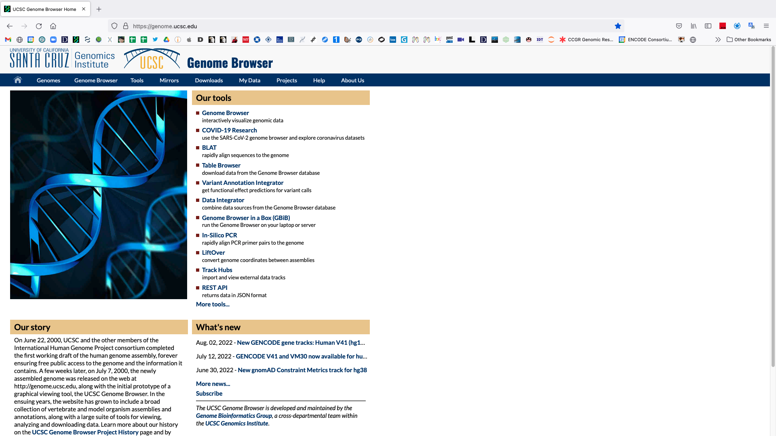
Open the University of California Santa Cruz genome browser website: https://genome.ucsc.edu/

Slide 2
Click on ‘Genomes’

Slide 3
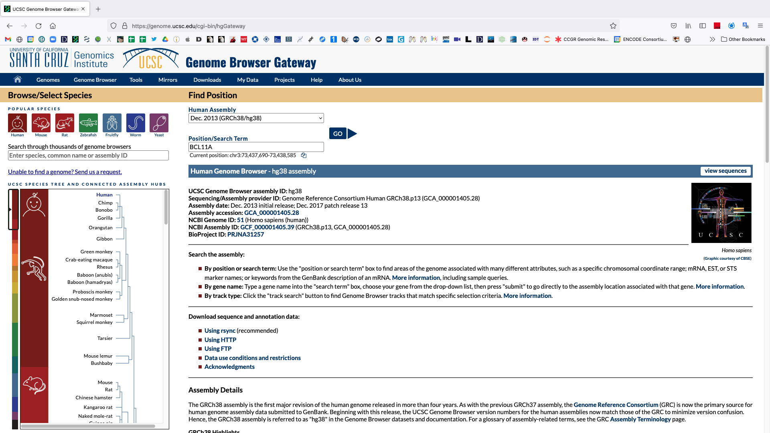
Use the hg38 assembly (ie version) of the human genome and enter BCL11A as the search term

Slide 4
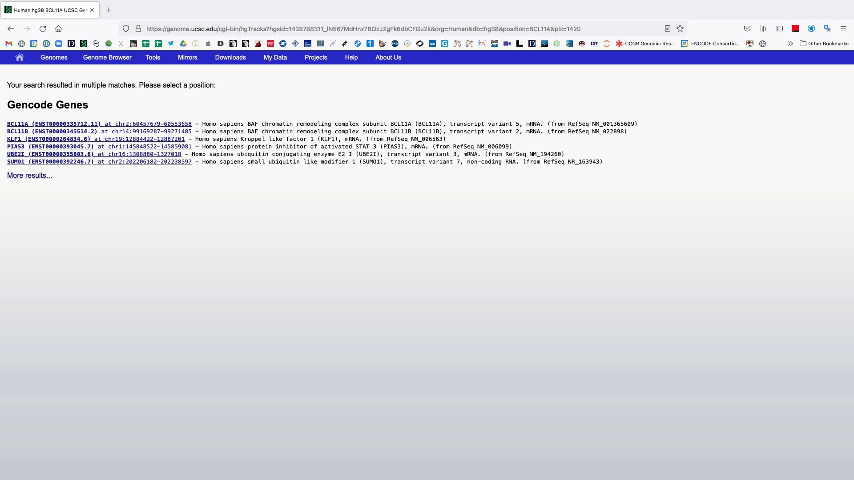
If your query has multiple matches be sure to select the correct one

Slide 5
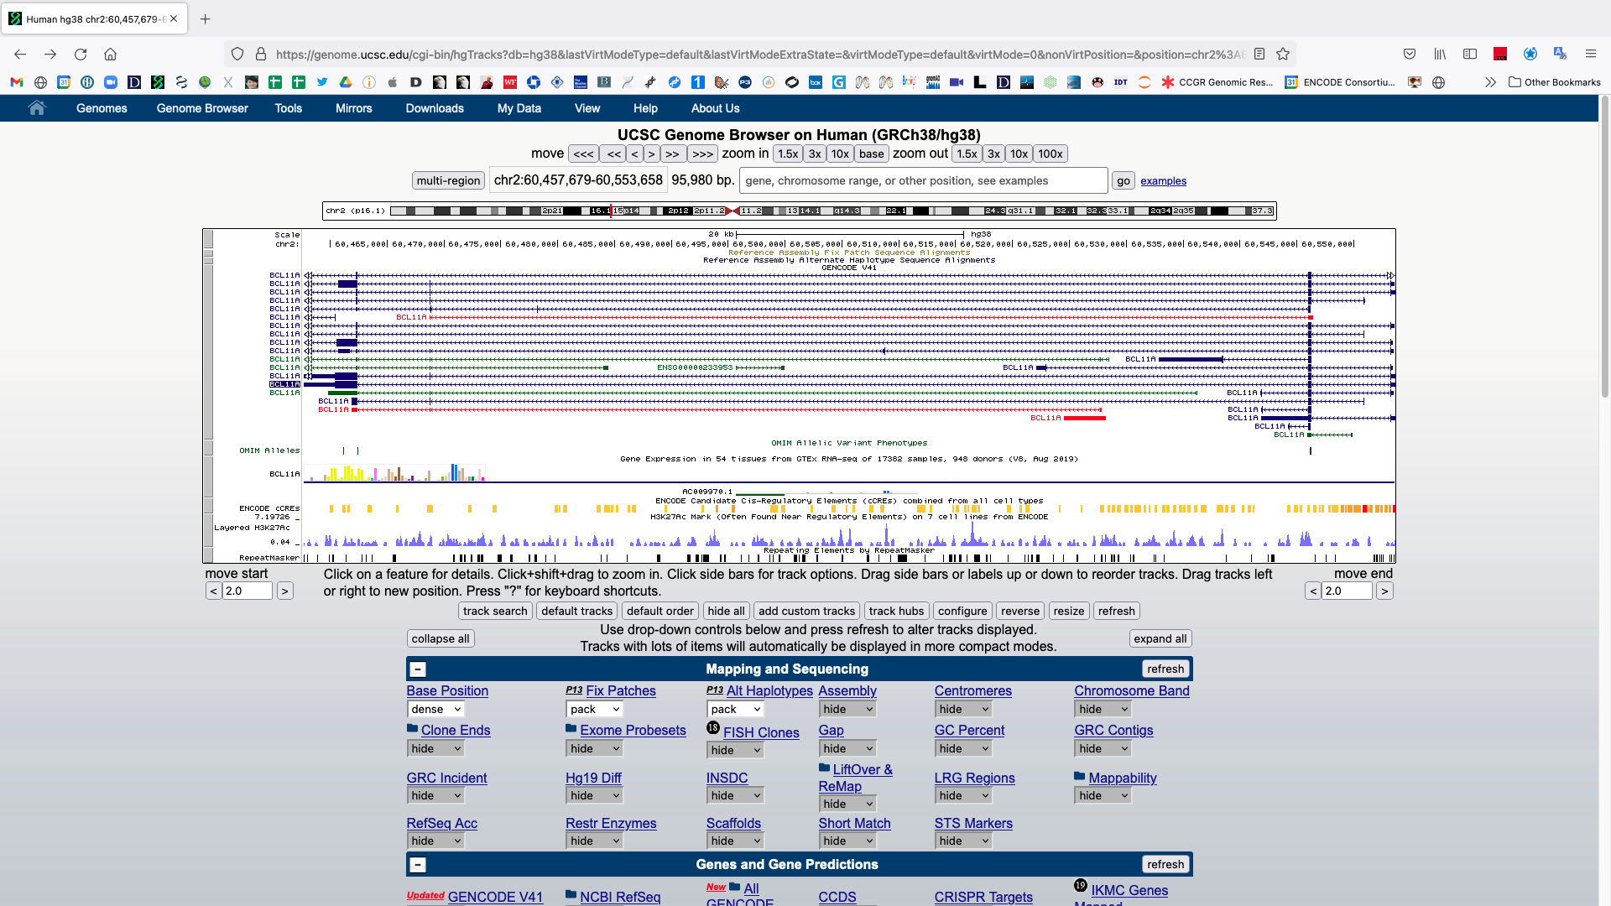
The default view of the BCL11A gene in the UCSC genome browser

Slide 6
The default view of the BCL11A gene in the UCSC genome browser
Each grey bar is a ‘track’.
The title of each track is centered in the browser.
Tracks are controlled below the browser.

Slide 7
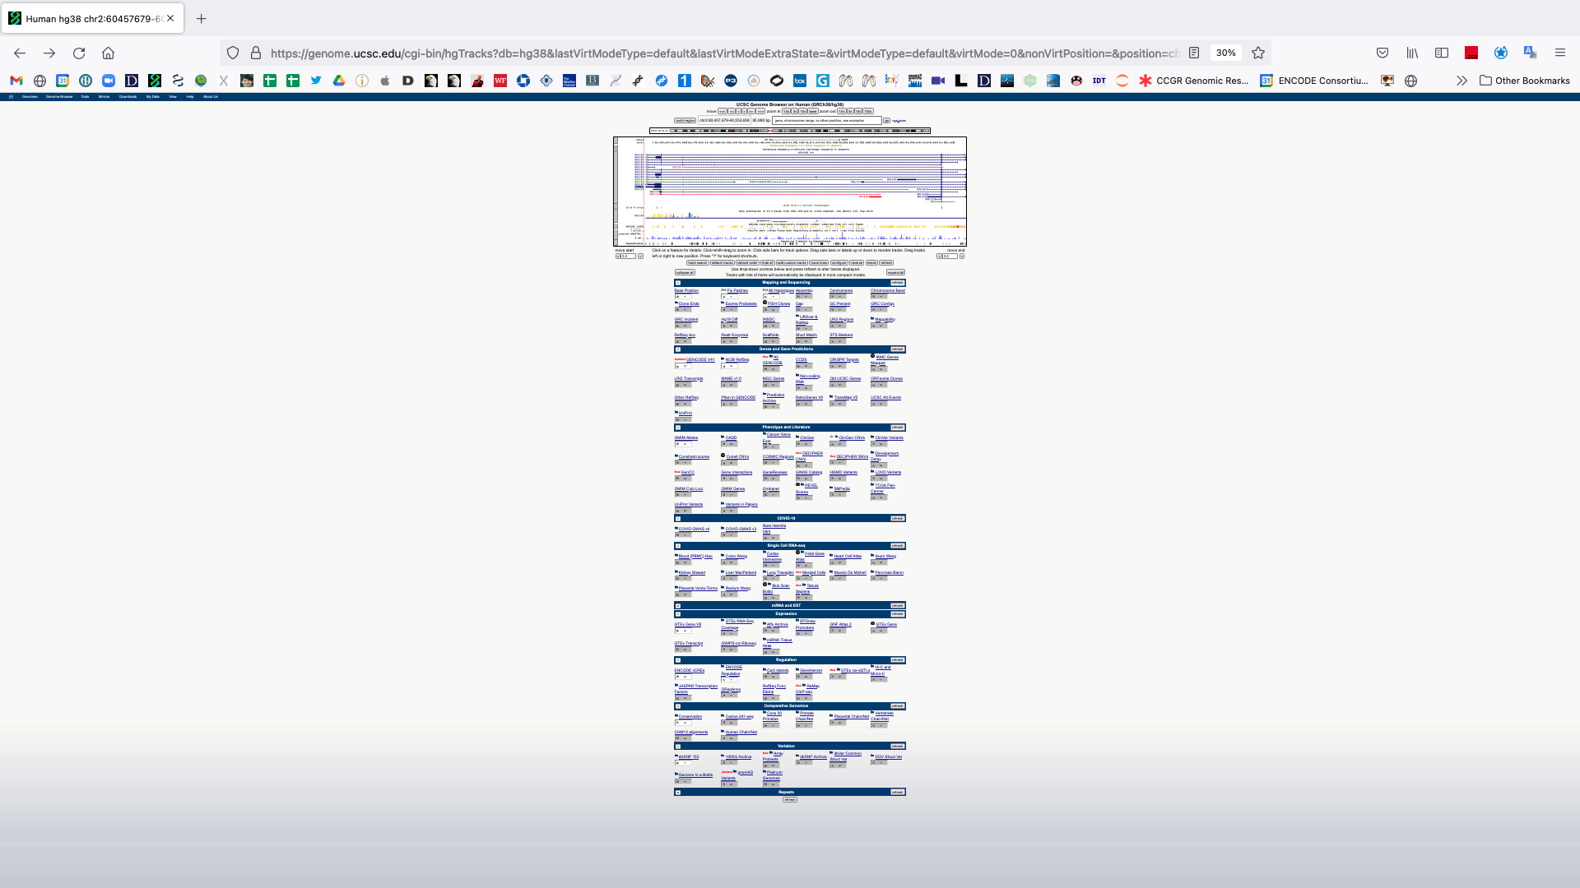
The full page
Each of these drop down menus allows for customizable visualization of tracks.
Data & annotations
Many options
Updates and new tracks occur semi-frequently
Clicking a blue header will display a page detailing that option.
Data type & source
Visualization description and options
External links with more information

Slide 8
The default view of the BCL11A gene in the UCSC genome browser
Different gene models/isoforms
Most common isoform

Slide 9
Zoom out
Click here

Slide 10
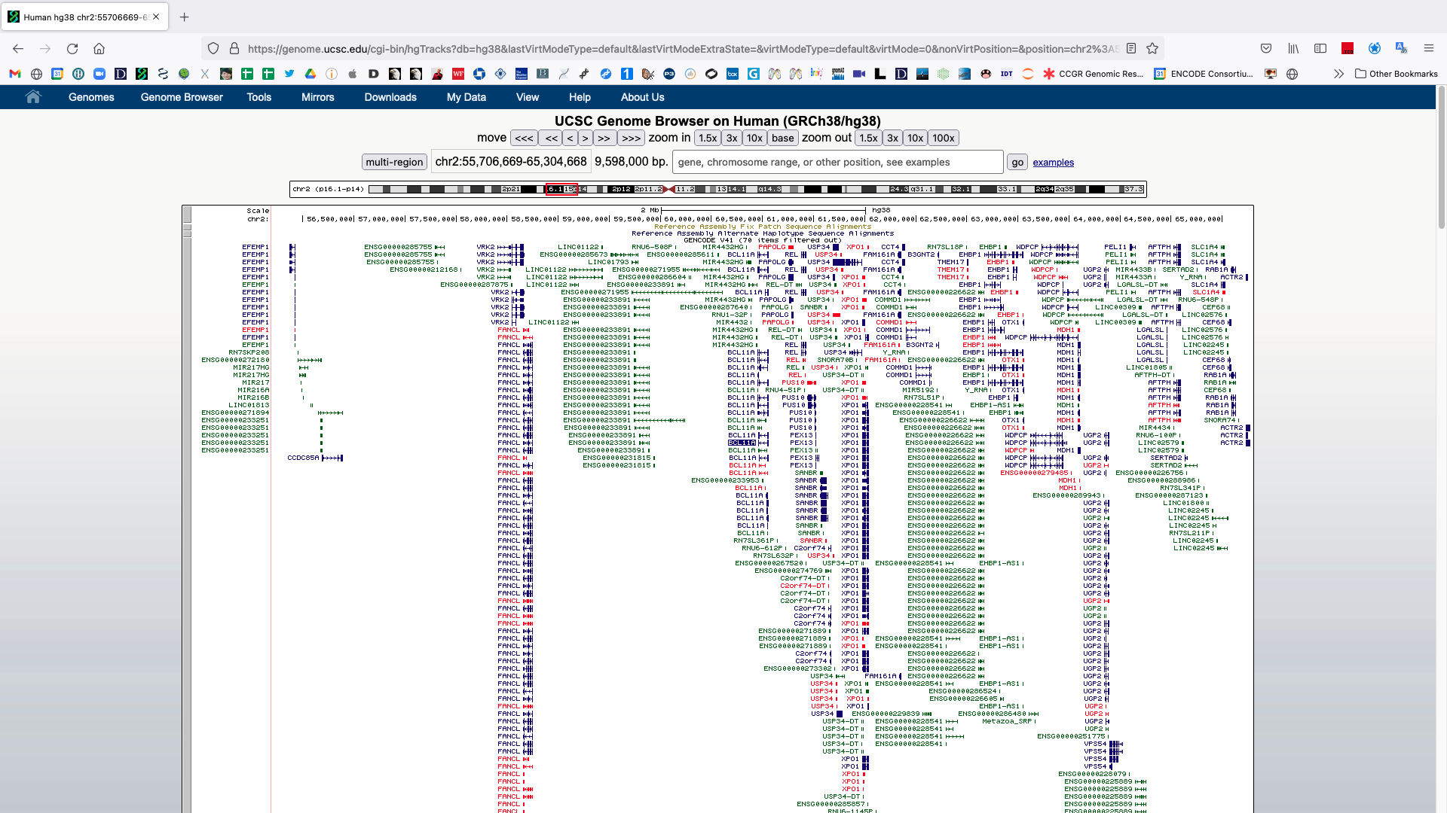
Many more genes can be observed when zoomed out

Slide 11
You can zoom in and out from 1 bp to a whole chromosome
Type in chr2:55,706,669 and hit ‘go’

Slide 12
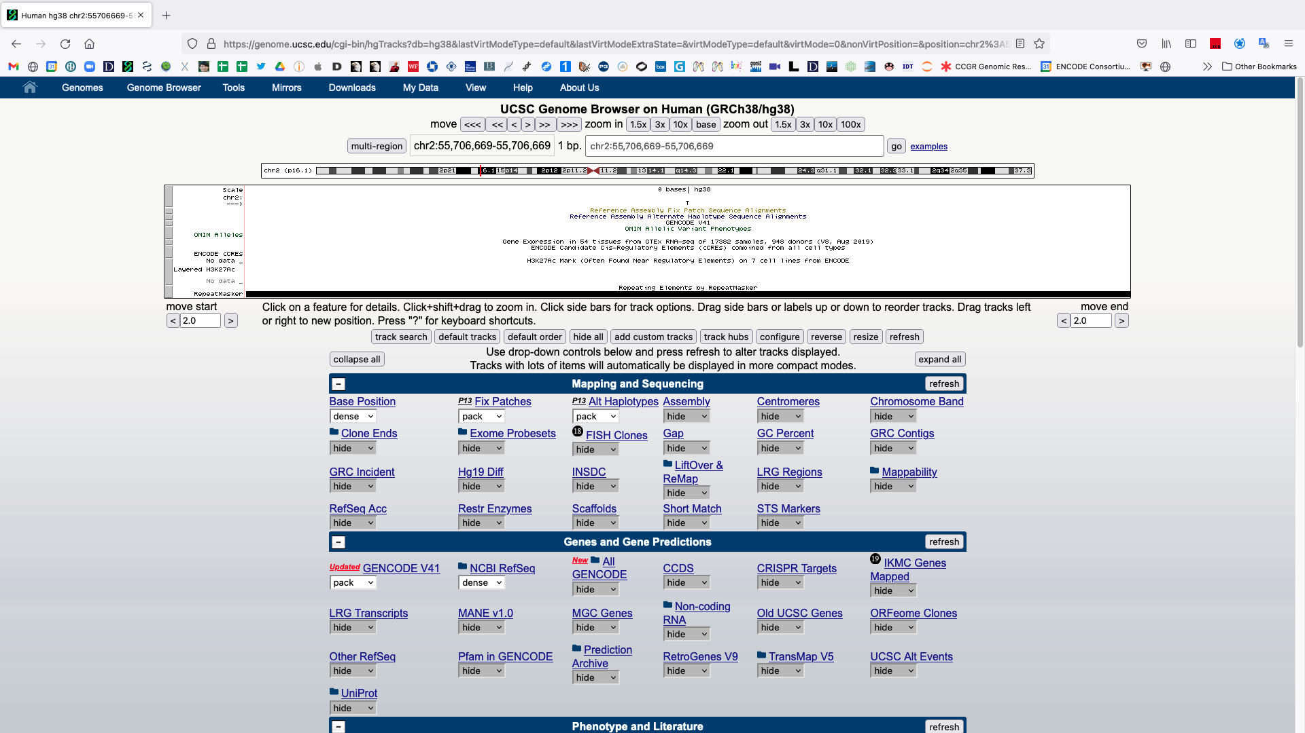
Single base
Notice how a one base pair coordinate position is represented
chr2 = chromosome 2
55,706,669 = this base is the 55,706,669th base on chr2
A single base pair (thymine)

Slide 13
Zoom out to three bases
Click here

Slide 14
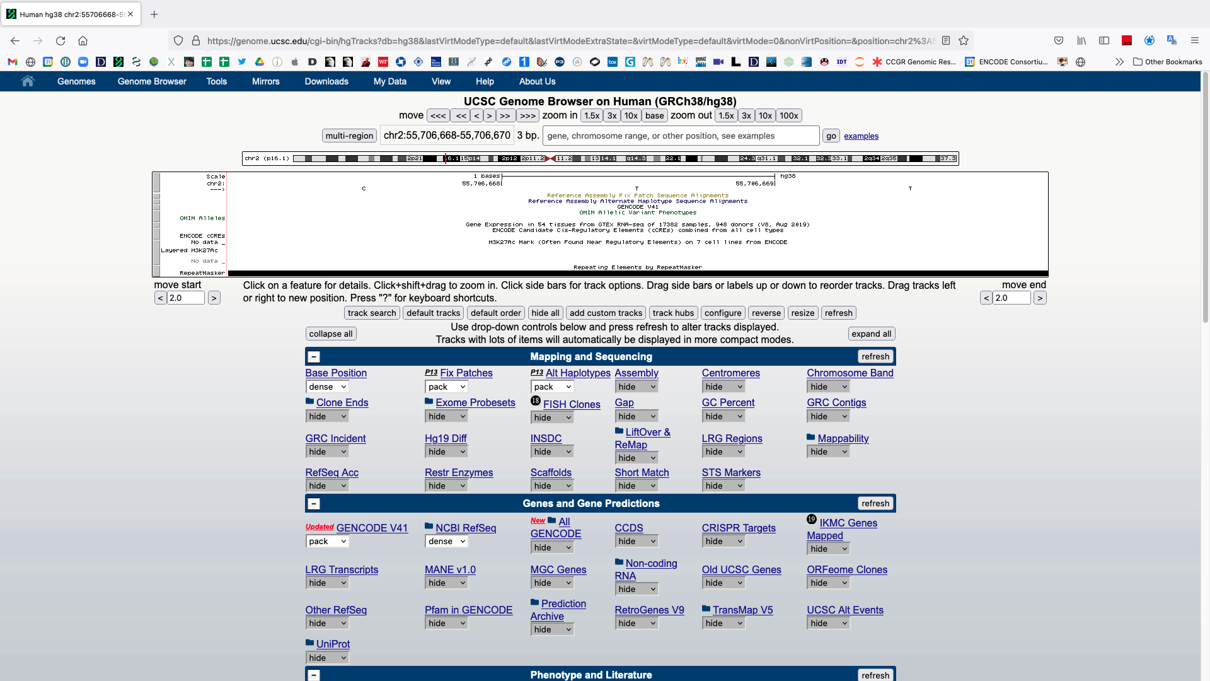
Notice how a coordinate position > 1 base pair (bp) is represented.
cytosine, thymine, thymine

Slide 15
Zoom out
Type in chr2 and hit ‘go’

Slide 16
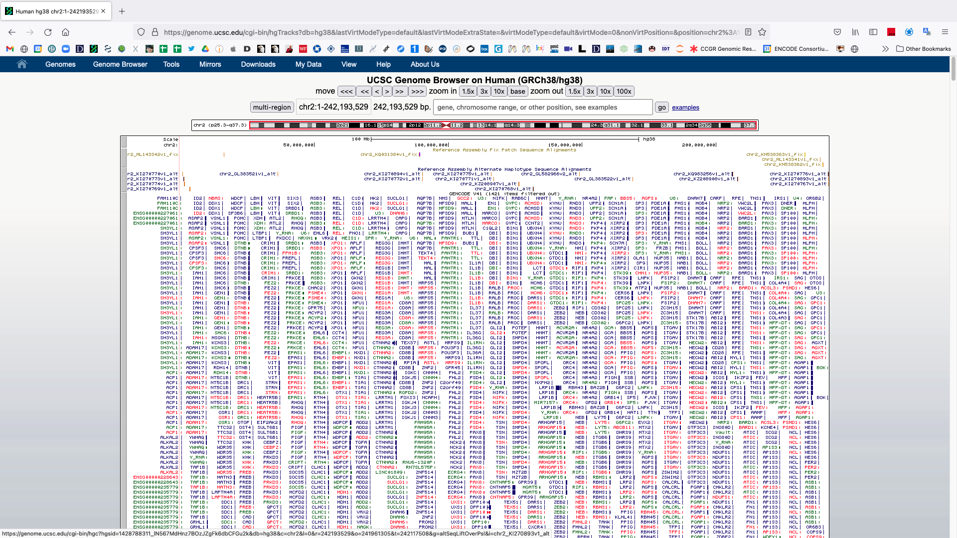
Chromosome 2
Notice the red box around the entire chromosome 2 ideogram
Too much information is being shown.
All known models for all genes on chr2.

Slide 17
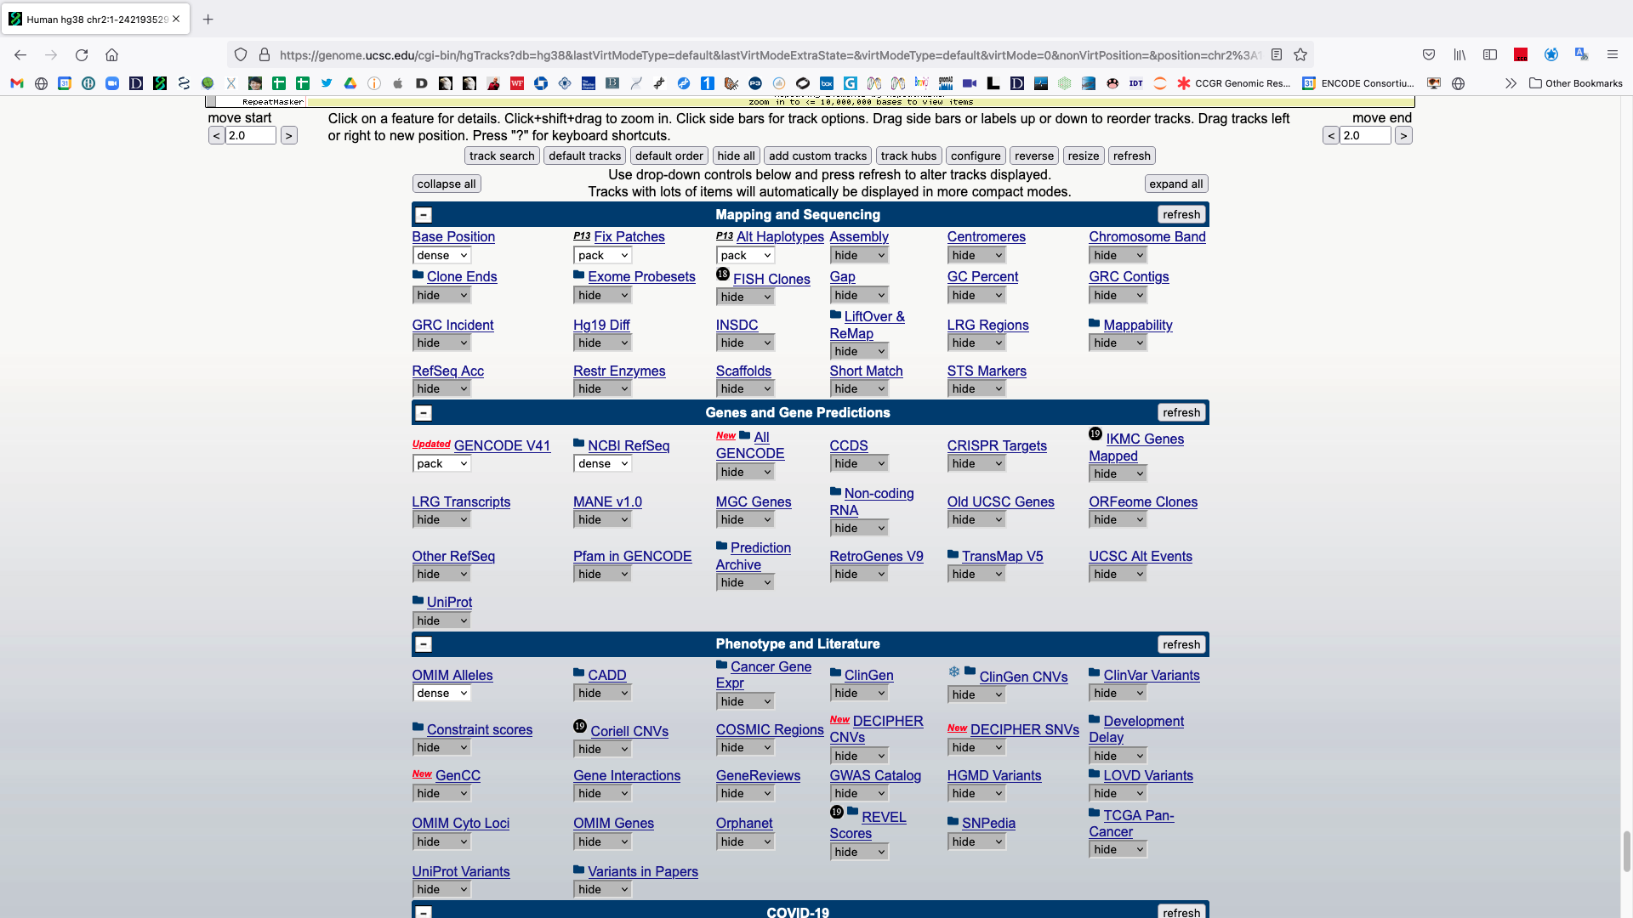
Adjust some settings
Scroll down and make the following changes:
GENCODE → squish
NCBI RefSeq → hide
OMIM Alleles → hide
GTEx Gene V8 → hide
Scroll down to find
After making the changes hit any ‘refresh’ button.

Slide 18
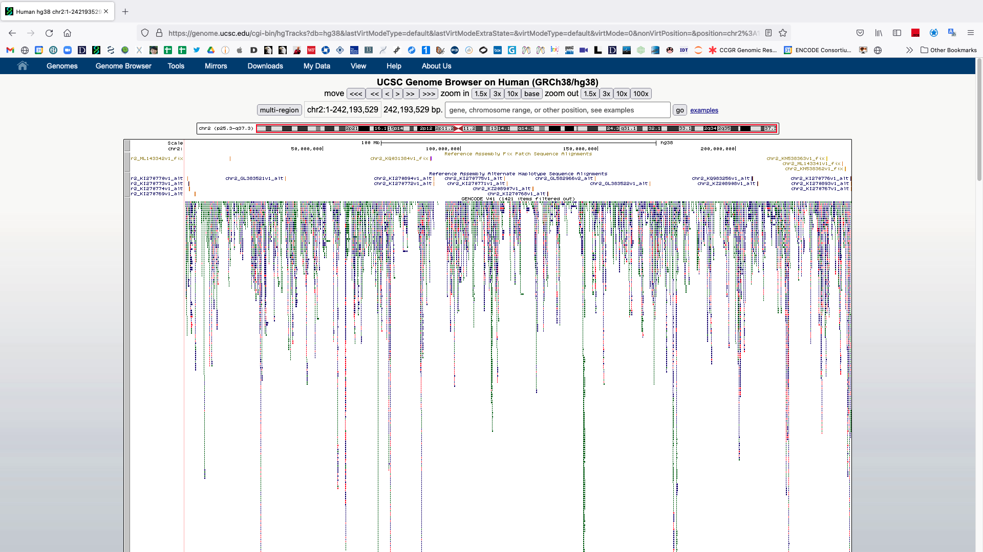
The gene models have been collapsed and other tracks removed (scroll down)

Slide 19
Tracks can be further modified by clicking on the grey bars to the left
Click on the GENCODE grey track bar

Slide 20
Track settings for the GENCODE track. These pages vary by track.

Slide 21
Change some options to hide data.
Click on “non-coding genes” and “splice variants” to hide the representation of these annotations.
Data visualization involves choices which impact interpretation, both yours and that of your audience.
Hiding these options can make interpreting data in a broad genome browser region more interpretable but removes information.
Hit ‘submit’ to see the changes.

Slide 22
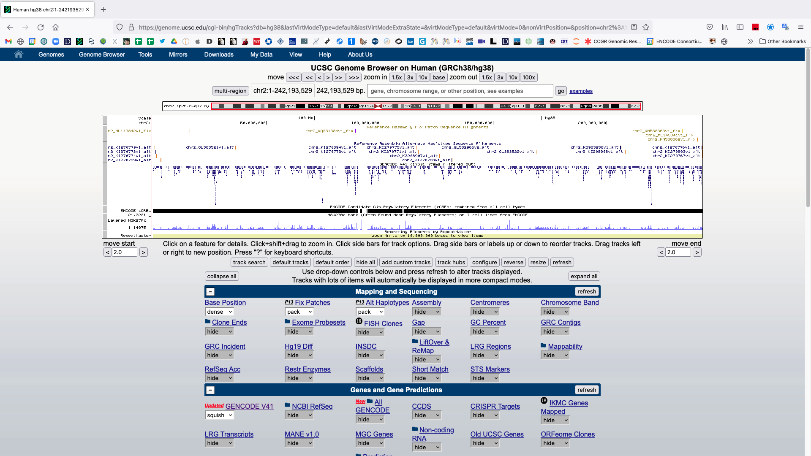
Now only a single model is shown for each gene. Return to BCL11A.
Type in BCL11A and hit ‘go’

Slide 23
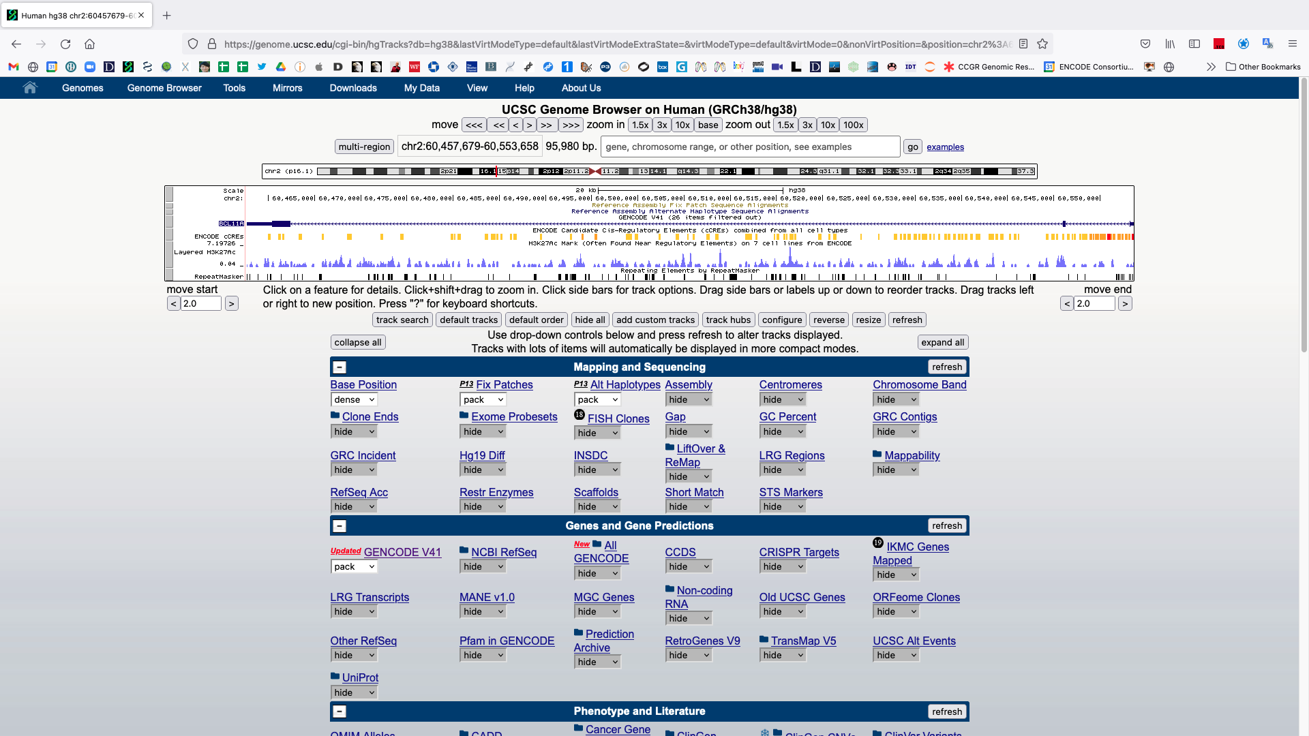
BCL11A & gene structure.

Slide 24
BCL11A & gene structure.
Notice the BCL11A’s position on chromosome 2
Ideogram (red vertical line)
chr:start-end coordinate
Exons are boxes
5' and 3' untranslated regions (UTRs) are thinner boxes
Introns are lines with arrowheads pointing in the direction of transcription

Slide 25
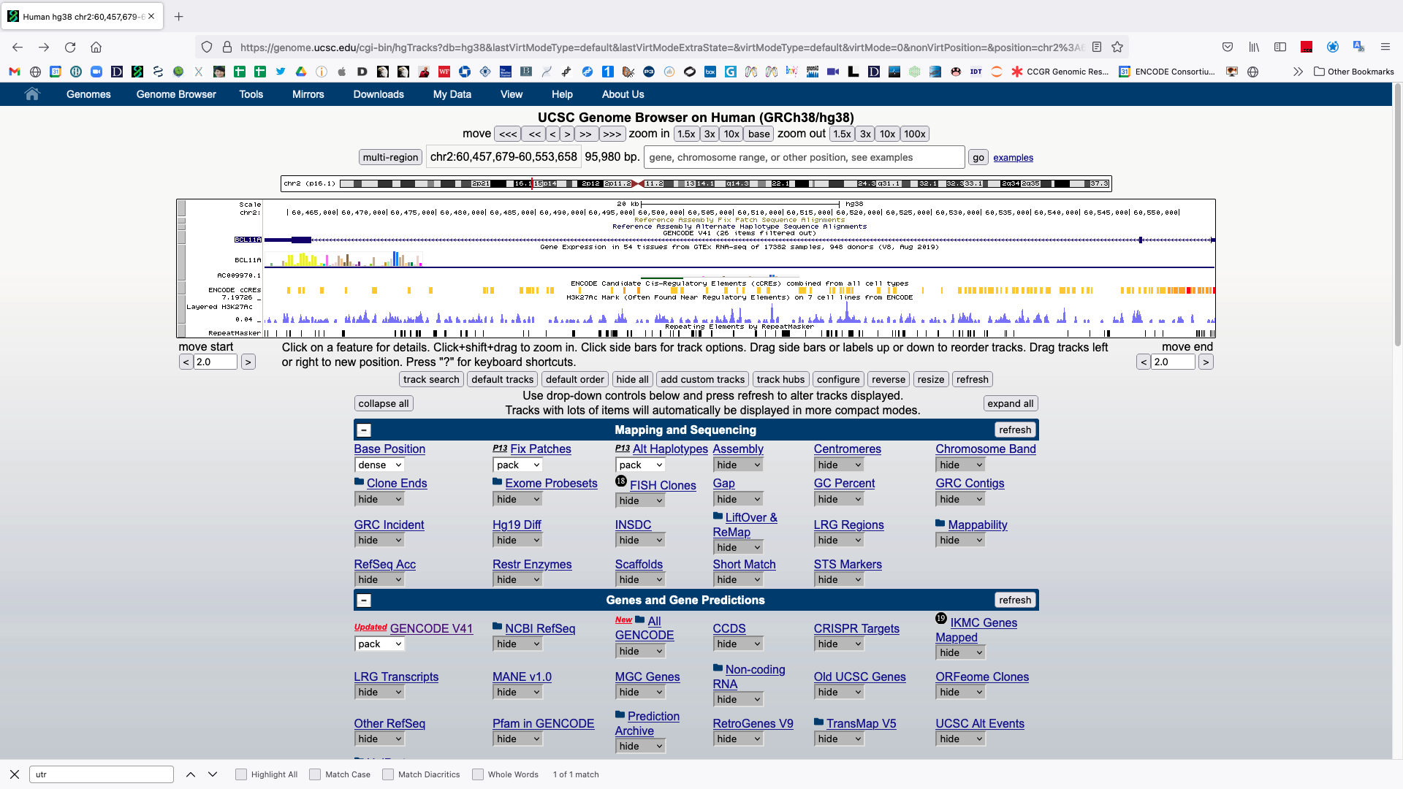
Scroll down and change the GTEX setting to ‘full’ and hit ‘refresh’.
Click the plot after refreshing

Slide 26
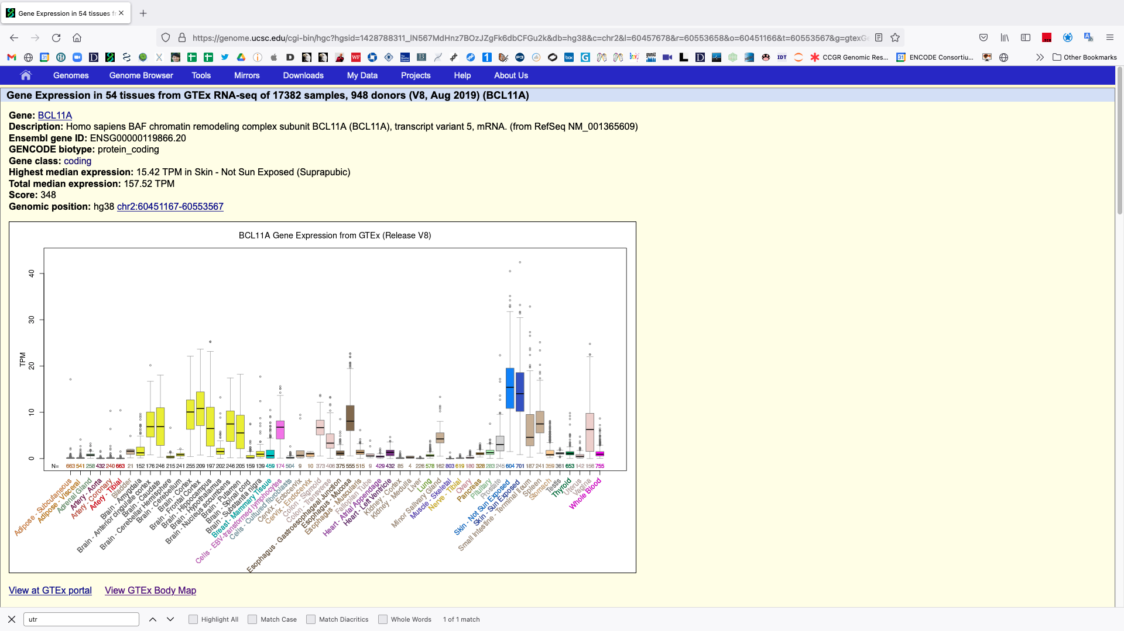
Primary tissue gene expression results from GTEX
TPM is the most common unit for describing the abundance of a transcript.
transcripts per million
Describes the amount relative to all other observed transcripts.

